Slide 1
From Still Panels to Motion, Kill Shakespeare Capstone
Jeremy Eldred

Slide 2
The Main Idea
With the usage of the Adobe Creative Suite (Photoshop, After Effects, Premiere Pro) we created a moving picture show from comic panels shown in Kill Shakespeare.
Each example will be shown as Before and After. Before being how the panel looks in the comic, and after being what I worked on and presented in the show.

Slide 3
How Each Program Was Used
Photoshop: Created layers from certain pieces that are printed on each panel (Swords, limbs, fire, ect.) Then polished over the images so adding motion doesn’t take away from the original image.
After Effects: Added video effects and motion to several panels.
Premiere Pro: Created video loops and also used for motion when panels did not require video effects as well.

Slide 4
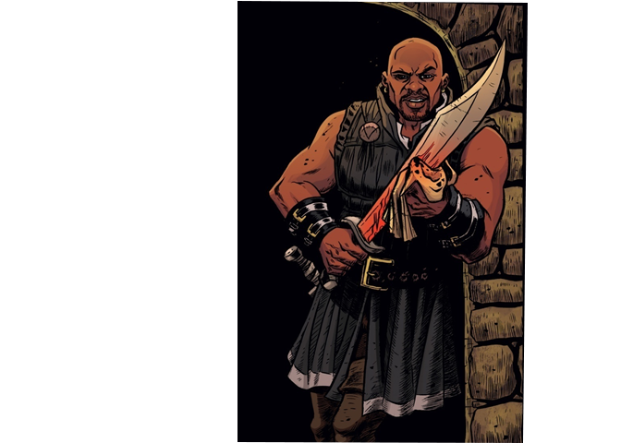
Example of Added Motion

Slide 5
Example of Added Motion/Video Effects

Slide 6
Example of Added Motion/ Video Effects

Slide 7
Example of Added Motion

Slide 8
Example of Video Effects

Slide 9
Example of Video Effects

Slide 10
Notes
While I did work on several other panels, I was not the sole media editor for them, so they were not included.

